Slide 1
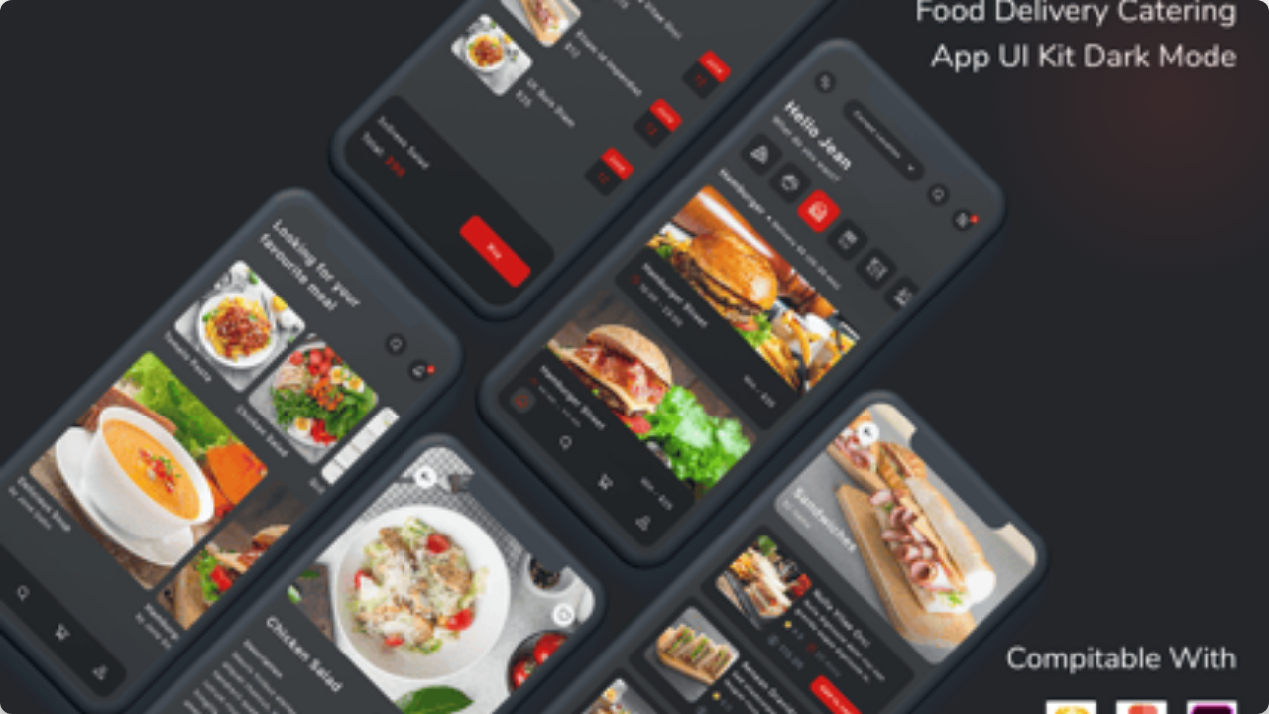

Exploring New
Ad Formats
Nov 2025 | Kelly Peterson

Slide 2

Context
33%
One-third of customers do not recall seeing any ads on DoorDash.
This suggests significant ad blindness (primarily drive by banner blindness), prompting our sprint to explore new formats for better visibility and engagement.
Additionally, we are reaching high ad load (approx 25%) and need to explore new engaging ad formats.
Banner/Ad Blindness

Slide 3






Research Approach
1:1 Interviews
Prototype Walkthrough
Sentiment Analysis
In-depth sessions with 8 randomly selected DoorDash customers to understand their preferences
We reviewed an interactive prototype containing various ad formats embedded in a realistic journey.
We probed specifically for "likes" and "dislikes" during the flow, followed by post-task interviews.
See research brief here
Watch Cx interviews here

Slide 4
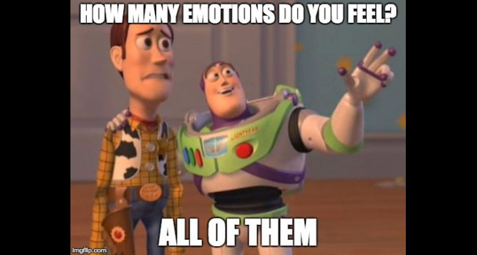
How do Cx feel about the new ad formats on DoorDash?

Slide 5
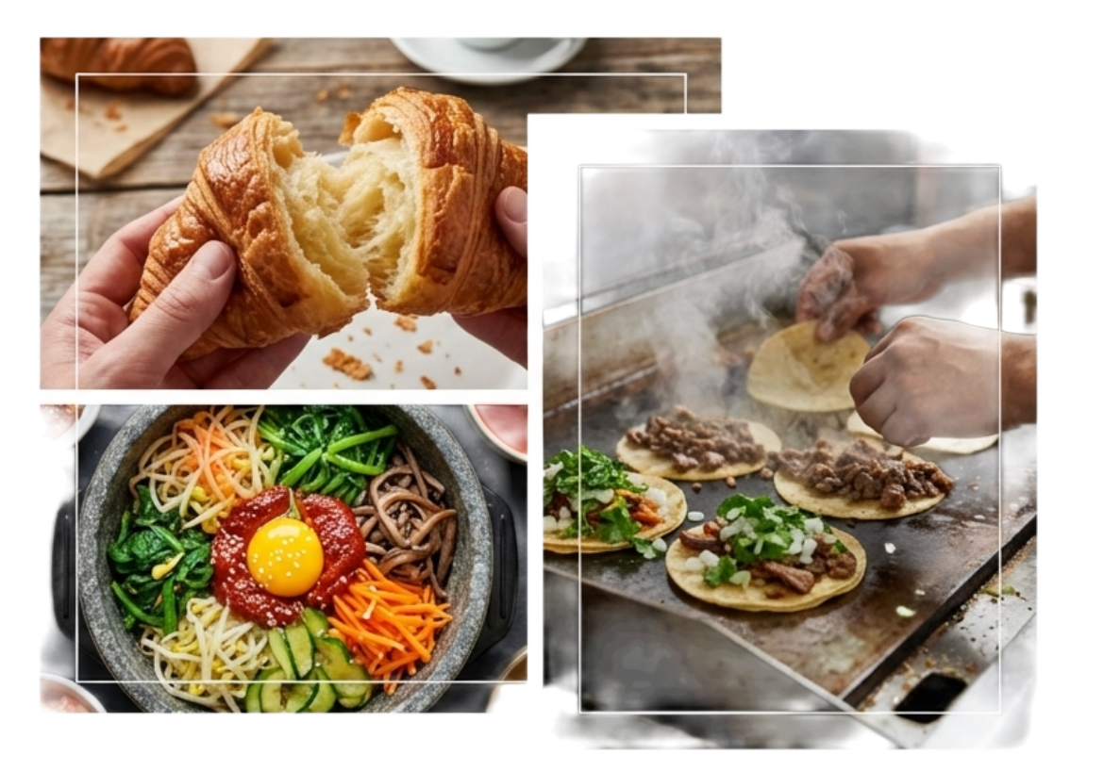
Championing the new & local
Discovery is welcome (sometimes)
Ads are viewed positively when they introduce unique options, especially from smaller or local businesses.
Seeing videos from smaller businesses is helpful... allows customers to actually see what they offer.
Users perceive ads from local SMBs as "suggestions" rather than "commercials," creating a higher trust factor.

Slide 6
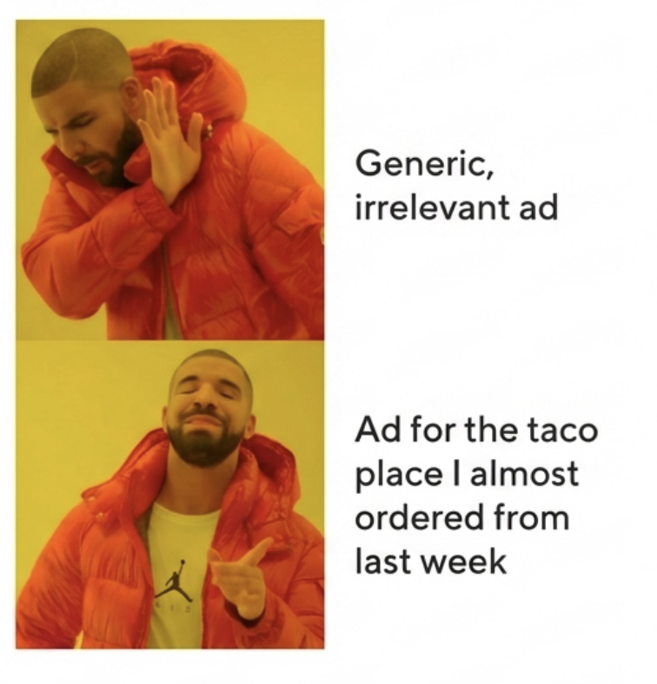
"If It's Not For Me, I Don't See It"
Relevance is Non-Negotiable
Customers are highly selective. They only notice ads that align with their order history or current cravings.
The Blind Spot: Generic ads are mentally filtered out immediately.
•
The Hook: A user who orders Sushi is far more likely to notice a Poke bowl ad than a Taco promo.
•

Slide 7
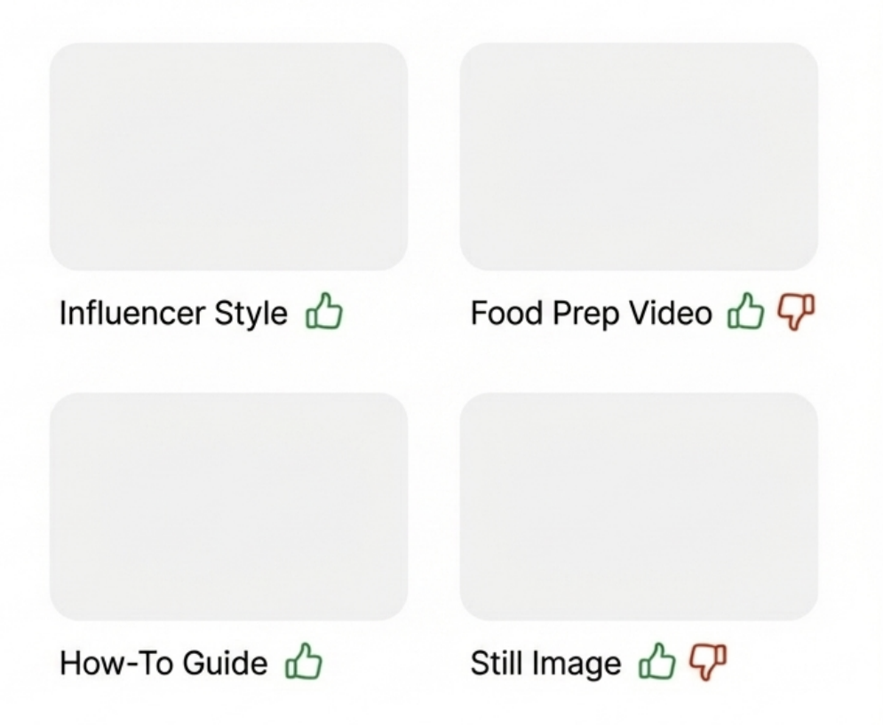
Personalization isn’t just what you show, but how you show it
Customers have very strong opinions on which formats work and do not work for them
Cx have strong likes and dislikes across influencer style videos, food videos, how to videos, and still images vs. videos
•
•

Slide 8
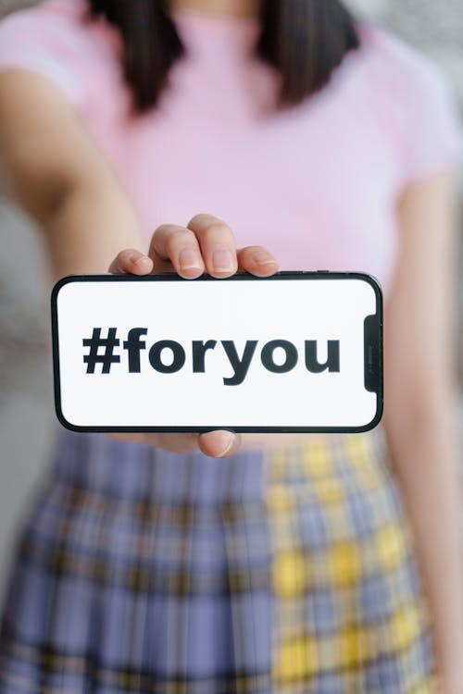
We have to get personalization right
Personalization is the most important factor for Ad success. Ad formats do not matter if the content we are providing doesn’t align with Cx preferences.
Personalization should go beyond the “what” we show and also align to the “where” , the “how” and the “how much”
•
•

Slide 9
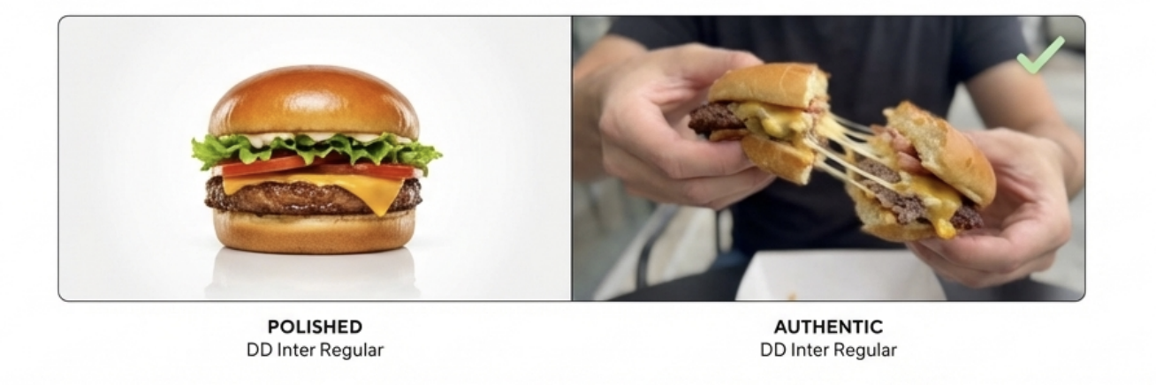
Authenticity builds trust
Real vs. Produced
The Authenticity Trap
Videos showing food actually being mixed, held, or eaten (influencer style) performed better than polished TV-style commercials.
However, balance is key. If it feels too much like social media ("Instagram-itis"), it becomes distracting and feels out of place in a utility app.

Slide 10
Cx have strong feelings about Ads & Mx Size
Lines start to get muddled for ENT vs. SMB for Cx when it comes to types of ads
“It's not helpful because we all know that's like when you're watching TV and you see all the different commercials for restaurants and stuff. Everybody knows what McDonald's restaurants are going to have as a advertisement.”
“They don't need my business. Like, oh, okay. They probably got enough business. They can afford to sponsor an ad. They can, you know, probably reach more people through that sponsorship, so let me shop somewhere a little more low-key or something.”
“But when you don't typically see because sometimes the smaller businesses don't have the money to spend on advertisements for TV and things like that. When you see local or small businesses, it's like, okay, now I get to actually see what you all offer”

Slide 11

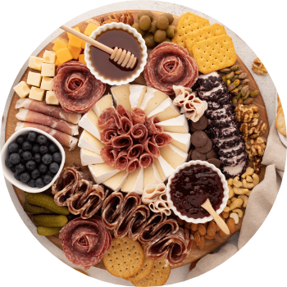
Utility as Marketing
Teaches or Inspires
Content that functions as a tool is not perceived as an annoyance.
•
Example: "How-to" guides (e.g., Charcuterie board assembly).
•
Example: Recipe ideas (e.g., Creative uses for Ritz crackers).
This shifts the perception from "Demanding a purchase" to “giving inspiration”
This is particularly true for CPG/NV products

Slide 12
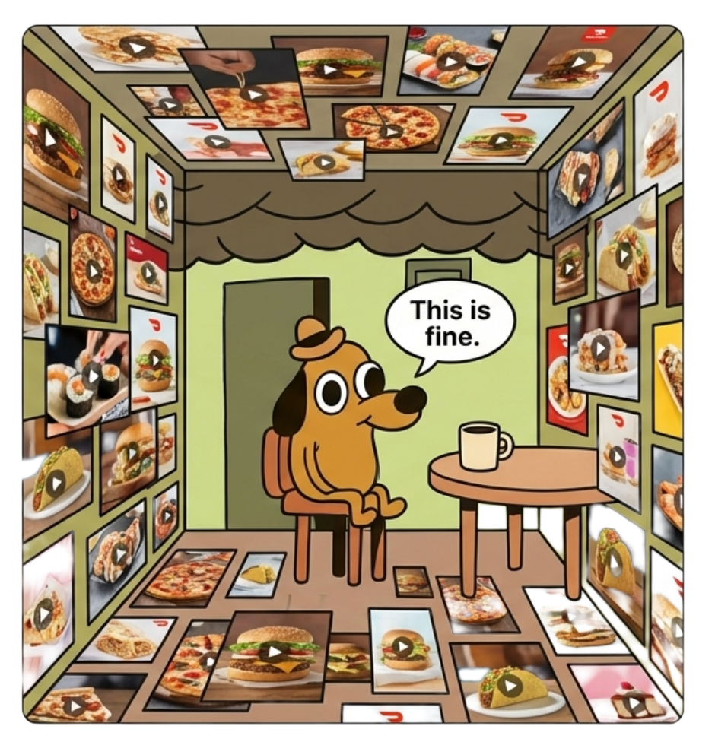
Too much clutter creates “instagram-itis”
A major complaint was that too many videos or advertisements make the app feel cluttered busy or hectic,
The movement of the videos was distracting, especially when looking for a specific restaurant, cuisine or item.
•
•

Slide 13
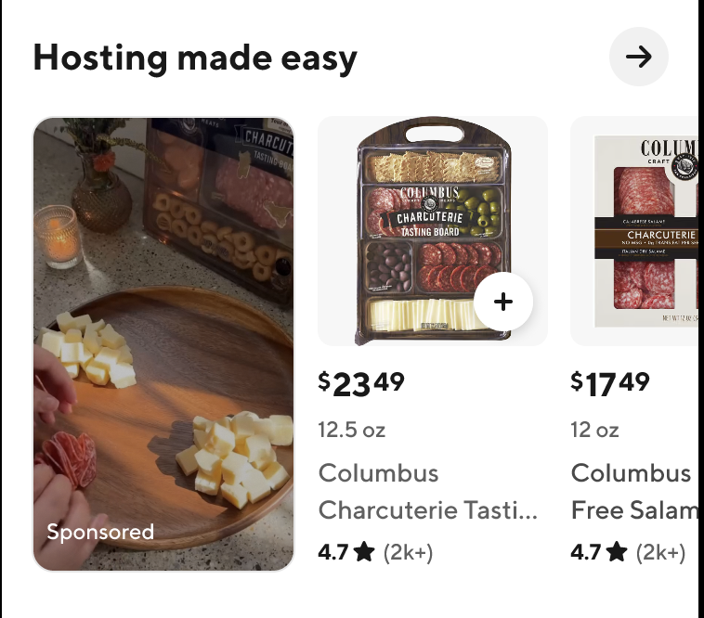
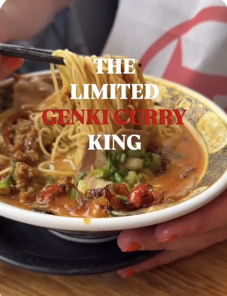
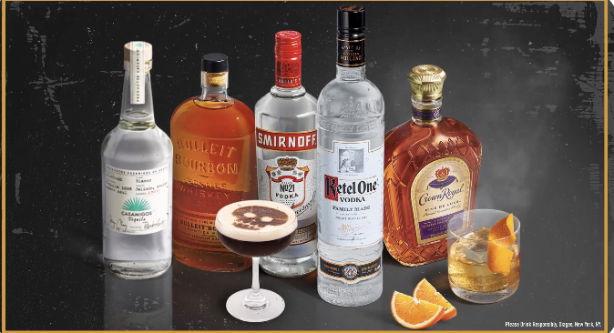
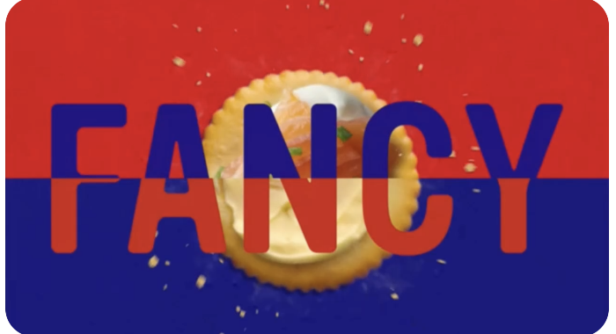
Creative guidance should be provided wherever possible
Working closely with our Mx and advertisers will be critical to ensure the success of ads on the DoorDash platform.
Ads should feel more authentic vs. “commercial”
Consider a “how to” approach
Keep motion “simpler”
•
•

Slide 14
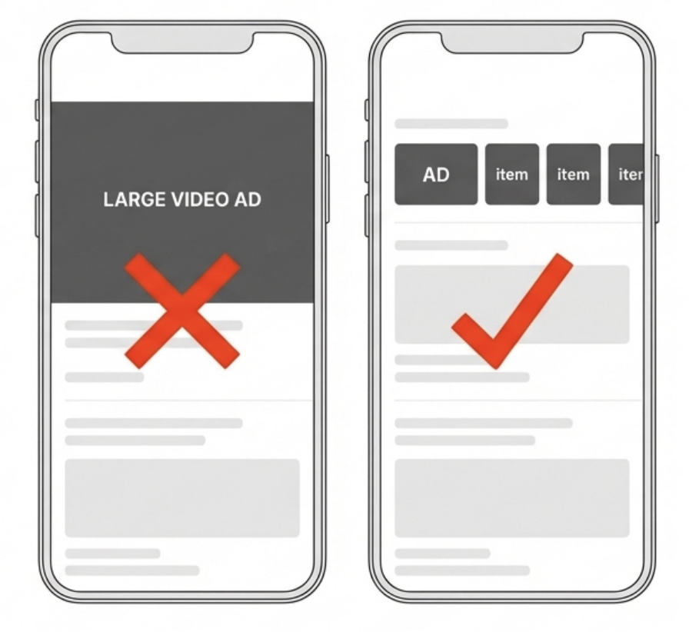
Bigger is not always better
Large videos that take up significant real estate feel intrusive
•
•

Slide 15
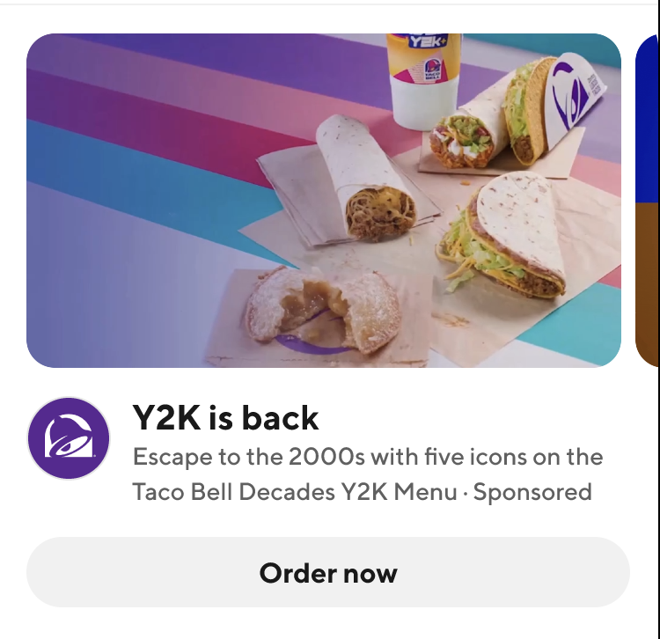
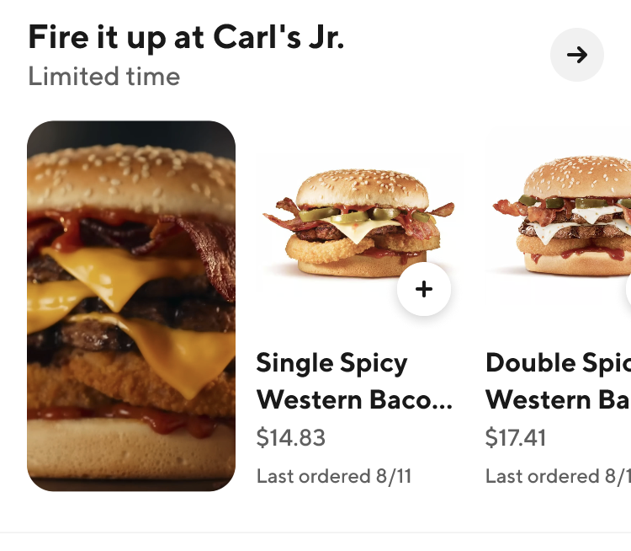
Large spotlights should be incredibly limited; we should rely on smaller spotlights
•
•
Large spotlights should be reserved for HYPER personalized content or important time limited or occasion based ads
Smaller spotlights should be used more regularly instead; item previews should be included wherever possible

Slide 16
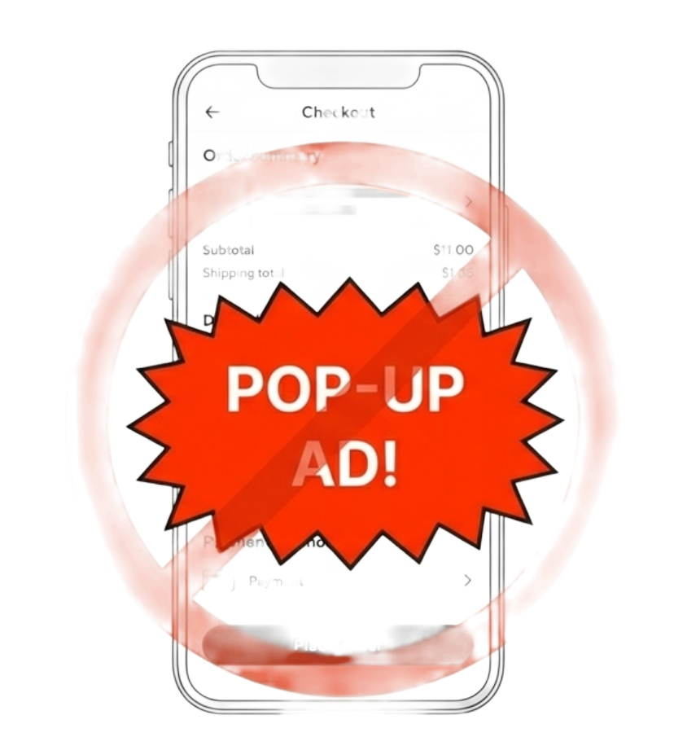
Cx are afraid that pop up videos are coming
Many indicate it would cause them to stop using the DoorDash app.
•
•

Slide 17
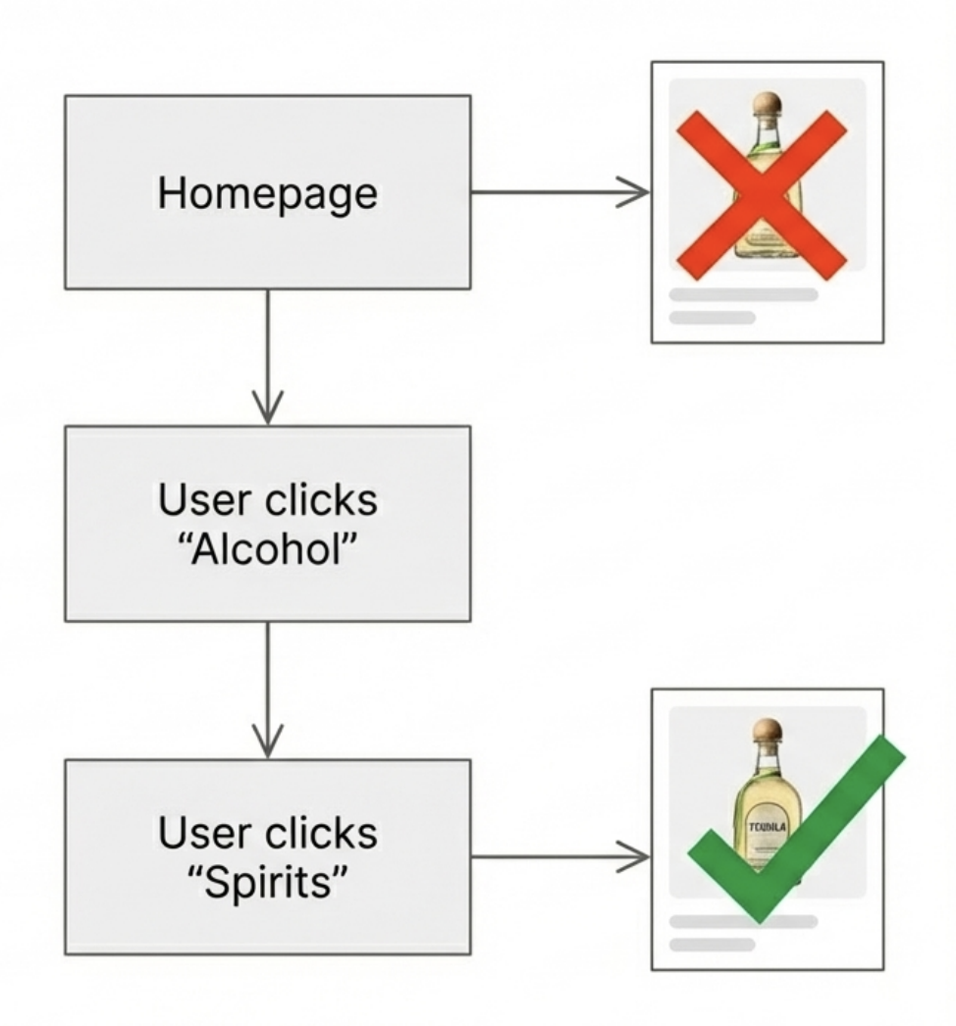
Placement is Everything
Meet Customers Where Their Brain Is
Placement strategy must align with the user's mental model.
•
Too Early: Homepage ads often feel disconnected.
•
Just Right: Ads placed within specific categories (e.g., inside the "Spirits" aisle) feel helpful and relevant.
Labeling Issue: The "Sponsored" tag can sometimes imply "Needs help selling," unintentionally lowering quality perception.

Slide 18
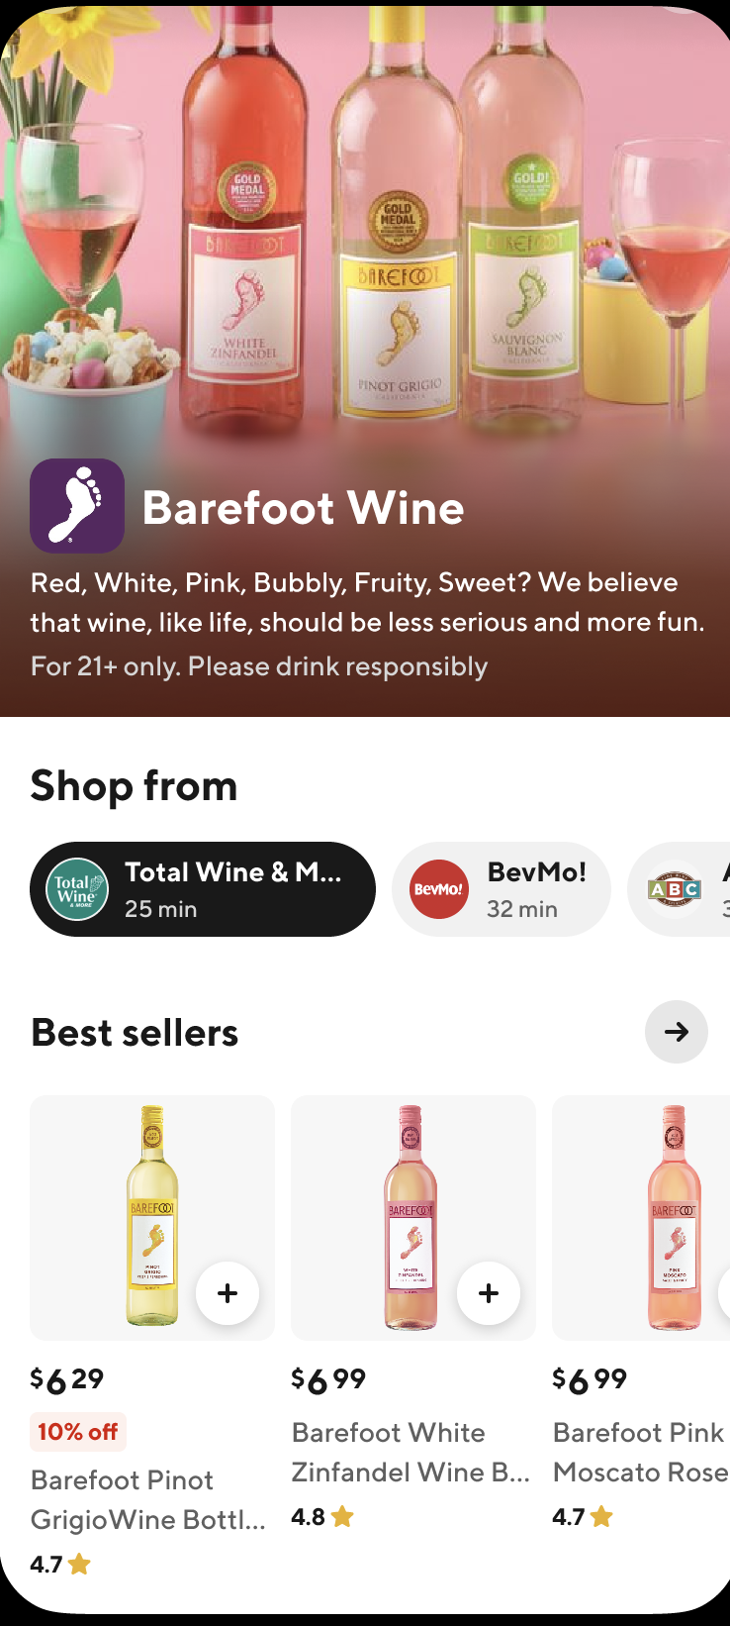
Brand pages add value but might need a different entry experience for in-app
Overall Cx felt the brand pages were valuable and visually appeals. Cx felt they were very similar to an Amazon experience which was familiar and useful, however…
•
The entry point for the brand page was not particularly obvious, Cx were likely to look for “similar to” items at the bottom instead
Cx felt they could easily get confused what actual store they are shopping in which could lead to a suboptimal delivery experience
There were concerns that a brand page experience could make the shopping experience more time consuming overall
•
We will explore this further in upcoming research around brand page entry points

Slide 19
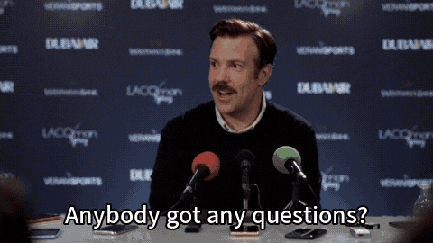
Any questions?

